Slide 1
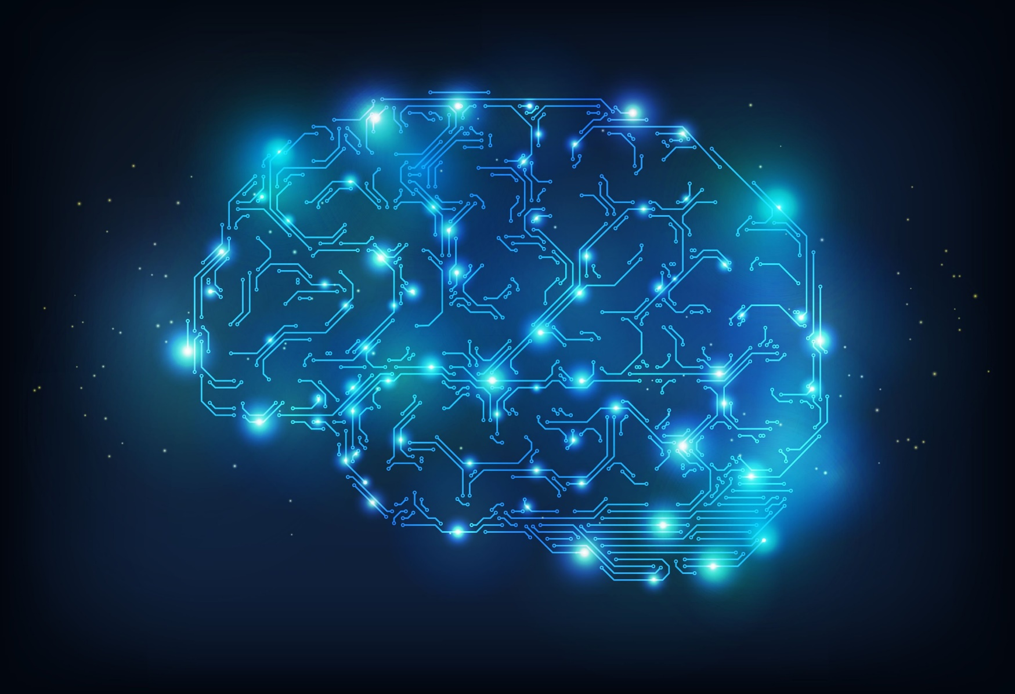


The path to Machine Learning
A developer’s journey

Slide 2

Who am I?
Full Stack Software Engineer @ Ordina
Backend top 3
.NET / .NET Core
Java
C
Frontend top 3
Angular
VueJS
Razor

Slide 3
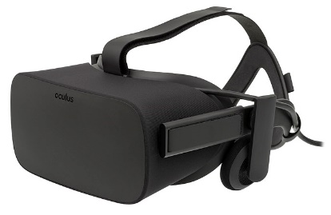

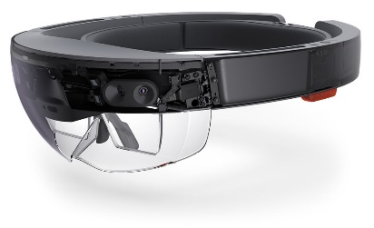
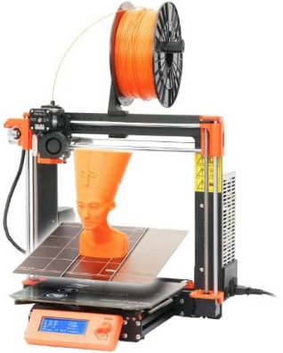
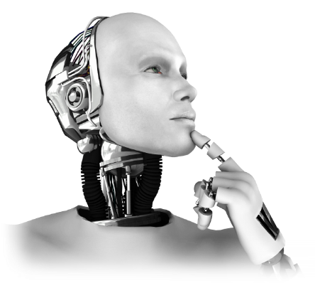
My passions
AR / VR
Photography
Makerspace
AI

Slide 4
Coming up
First steps
Importance of math
Key concepts
Frameworks and libraries
Cloud platforms
Future of Machine Learning

Slide 5

First steps

Slide 6


Slide 7


Slide 8

Machine Learning examples
Notes:
Email spam filters

Slide 9

Machine Learning examples
Notes:
Credit fraud detection

Slide 10

Machine Learning examples
Notes:
Personal assistants

Slide 11

Machine Learning examples
Notes:
Search engines

Slide 12
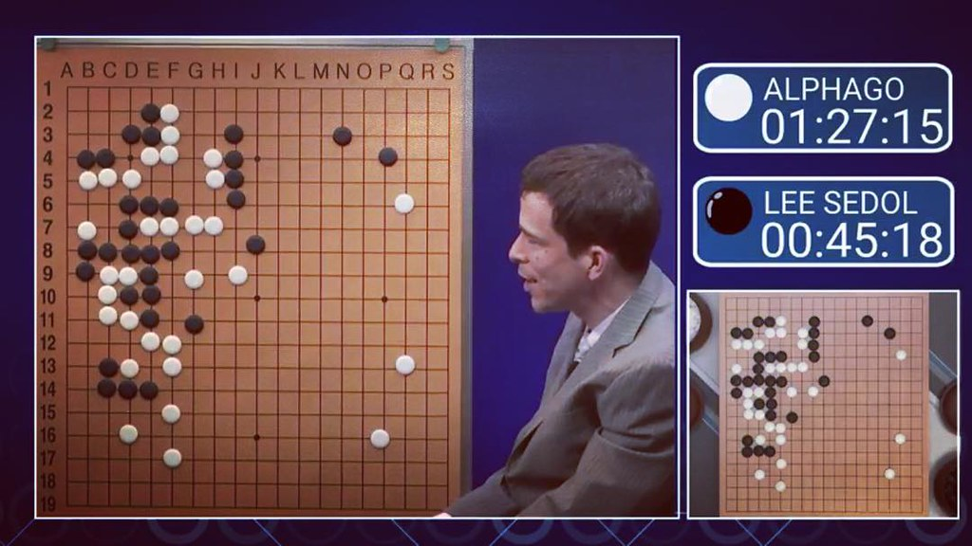
Machine Learning examples
Notes:
Games

Slide 13
Definitions (Oxford Dictionary)
Artificial Intelligence
“The theory and development of computer systems able to perform tasks normally requiring human intelligence, such as visual perception, speech recognition, decision-making, and translation between languages.”
Machine Learning
“A branch of artificial intelligence in which a computer generates rules underlying or based on raw data that has been fed into it.”

Slide 14
AI <> Machine Learning
Notes:
Machine Learning is a SUBSET of Artificial Intelligence

Slide 15

Types of Machine Learning
Notes:
Image source: http://www.cognub.com/index.php/cognitive-platform/

Slide 16
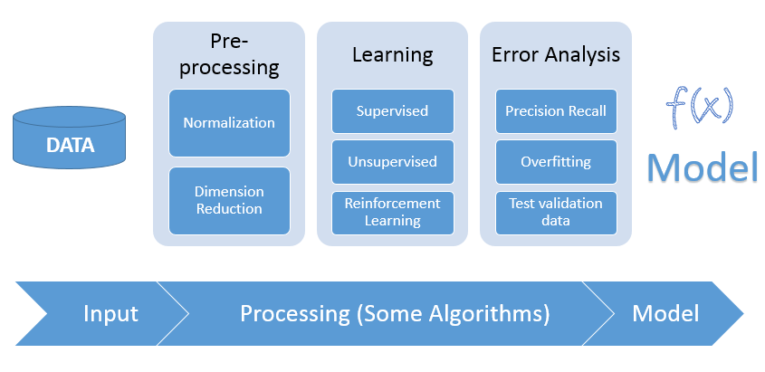
Machine Learning process
Notes:
Image source: https://blog.sujeetjaiswal.com/machine-learning-an-introduction-de88d85ebc5d

Slide 17
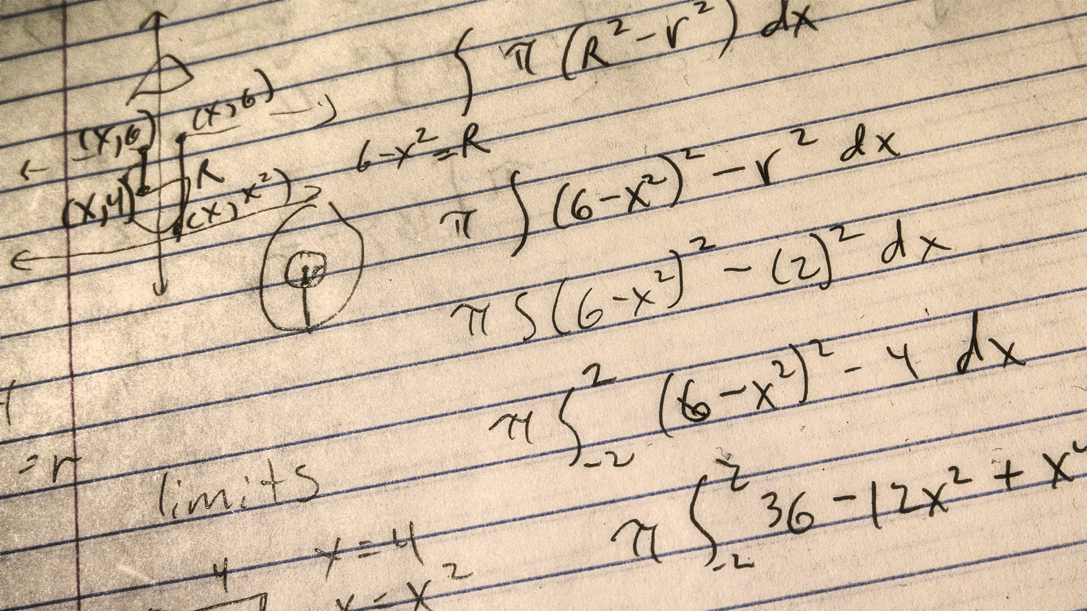
Importance of math

Slide 18
Do I need math skills?
NO!!!
But you often do need math skills on model refinement
If you are going to write your own custom algorithms
When you do not want to wait for an update of your favorite library

Slide 19
Fields of mathematics
Linear algebra
Multivariate calculus
Probability theory
Statistics

Slide 20

Key concepts

Slide 21
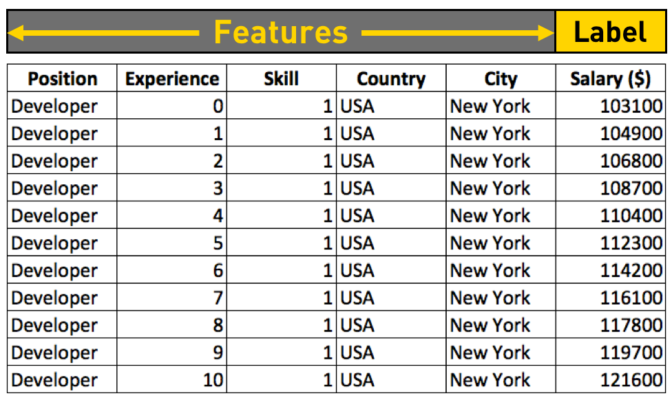
Features and labels

Slide 22
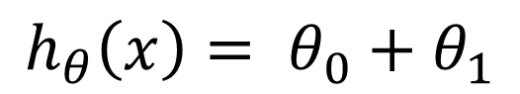
Hypothese
$$h_{θ}\left(x\right)= θ_{0}+θ_{1}$$
Input variable
Parameters
Notes:
Example is univariate linear regression

Slide 23
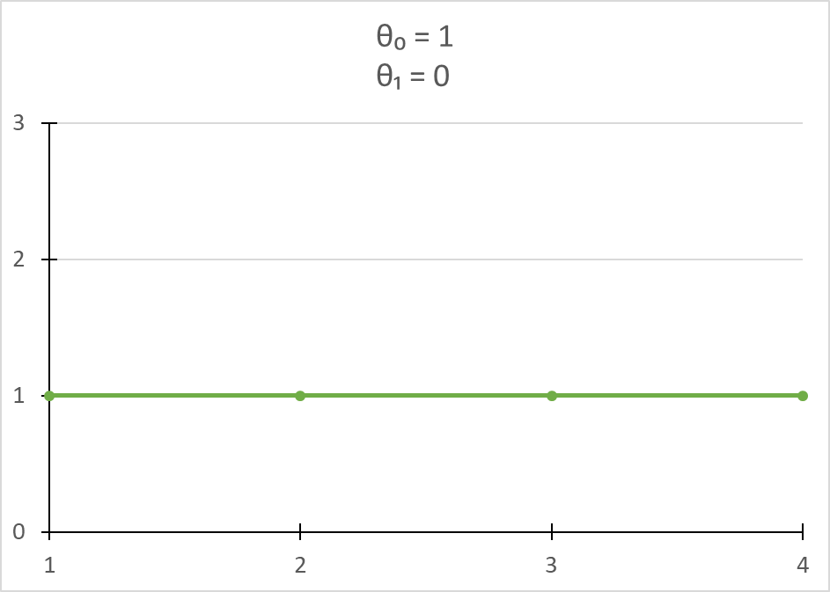
Hypothese
Notes:
Example is univariate linear regression

Slide 24
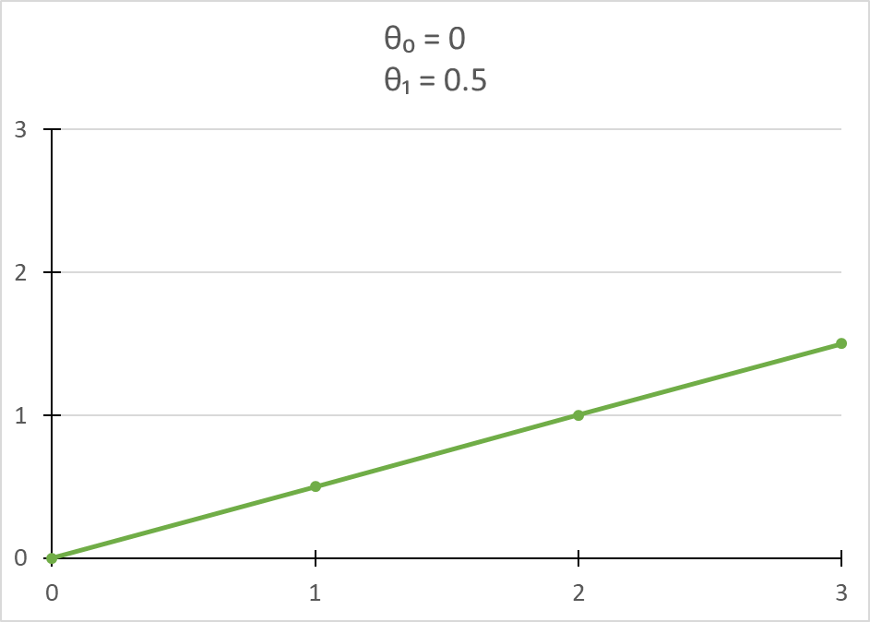
Hypothese
Notes:
Example is univariate linear regression

Slide 25
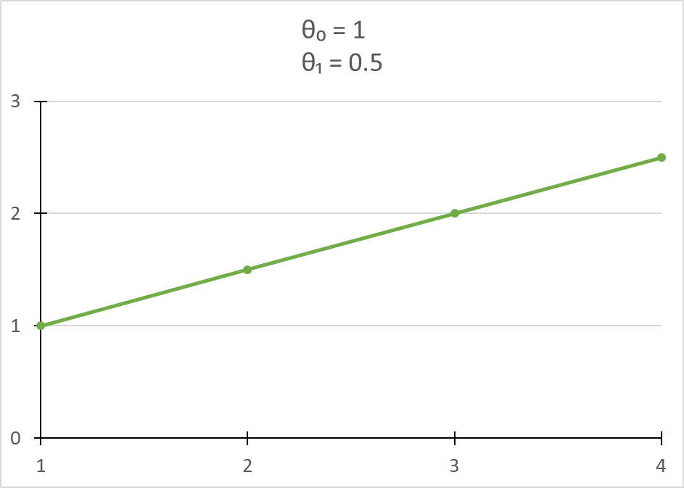
Hypothese
Notes:
Example is univariate linear regression

Slide 26
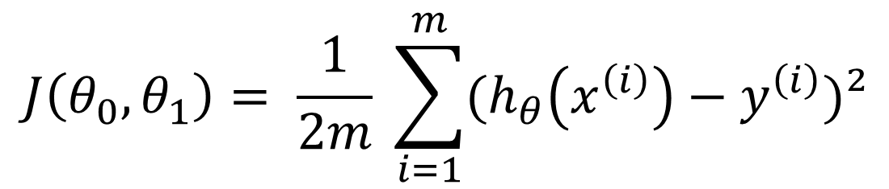
Cost function
$$J\left(θ_{0},θ_{1}\right)= \frac{1}{2m} \sum_{i=1}^{m}{(h_{θ}\left(x^{\left(i\right)}\right)−y^{\left(i\right)})²}$$
# training examples
Output variable
Minimize
Input variable
Notes:
Goals is to minimize: $J\left(θ_{0},θ_{1}\right)$

Slide 27
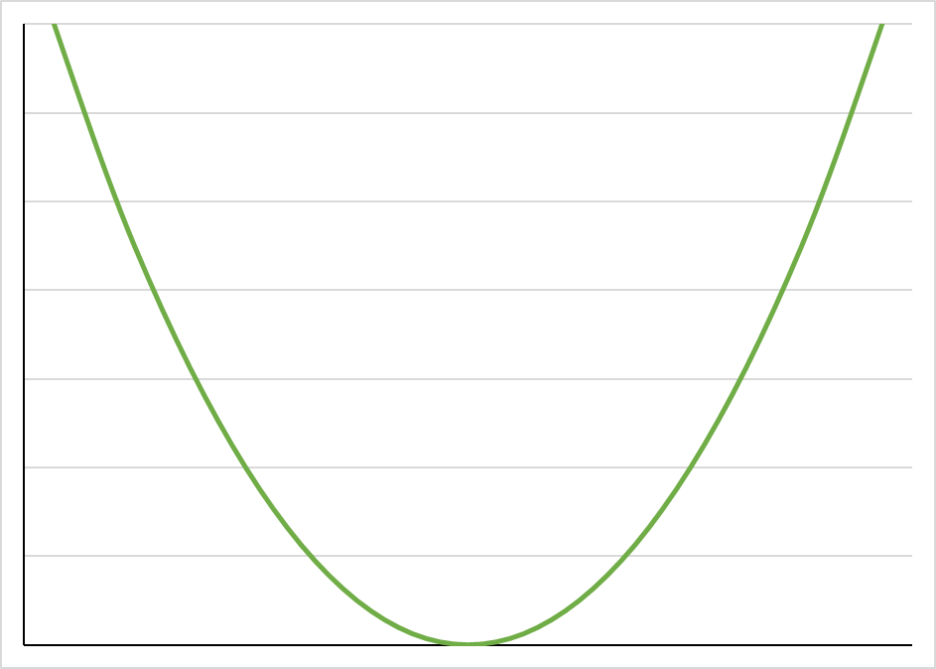
Gradient descent
Point of convergence

Slide 28
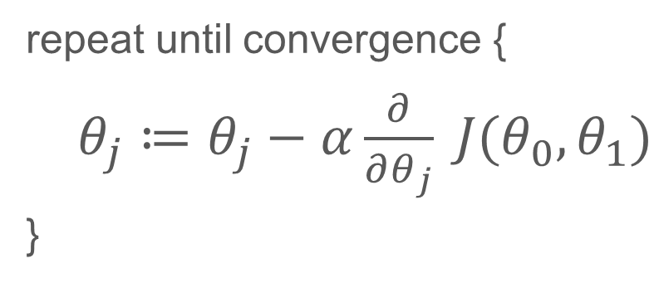
Gradient descent
repeat until convergence {
$θ_{j}≔θ_{j}−α\frac{∂}{∂θ_{j}} J(θ_{0},θ_{1})$
}
Step size/learning rate
Cost function
Derivative
Notes:
Step size * derivative
Derivative: measures the sensitivity to change

Slide 29
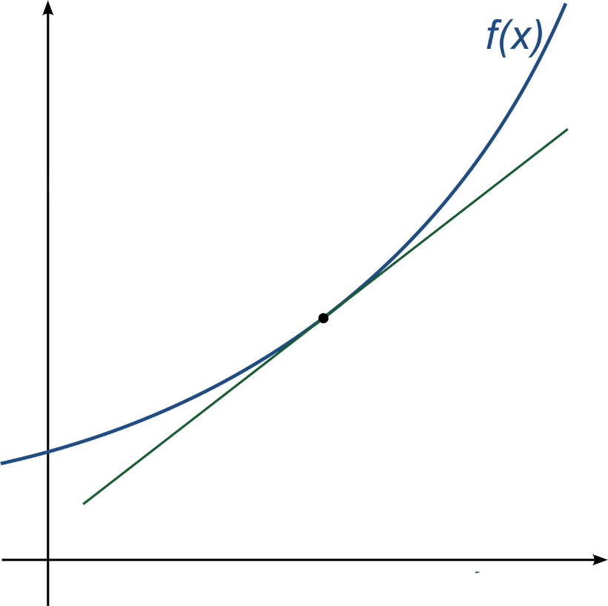
Gradient Descent
Notes:
Example of a derivative

Slide 30
Model accuracy
R²
RMSE
F-test
Precision-Recall-Accuracy
ROC-AUC
…
Notes:
R²: r squared => a statistical measure of how close the data are to the fitted regression line. It is also known as the coefficient of determination. RMSE is an absolute measure of fit
RMSE: root mean squared error => indicates the absolute fit of the model to the data–how close the observed data points are to the model’s predicted values. R-squared is a relative measure of fit. RMSE can be interpreted as the standard deviation of the unexplained variance.
F-test => evaluates the null hypothesis that all regression coefficients are equal to zero versus the alternative that at least one is not. The F-test determines whether the proposed relationship between the response variable and the set of predictors is statistically reliable.

Slide 31
Hyperparameter tuning
Finding “the best” values for the hyperparameters of your model
Often automated

Slide 32
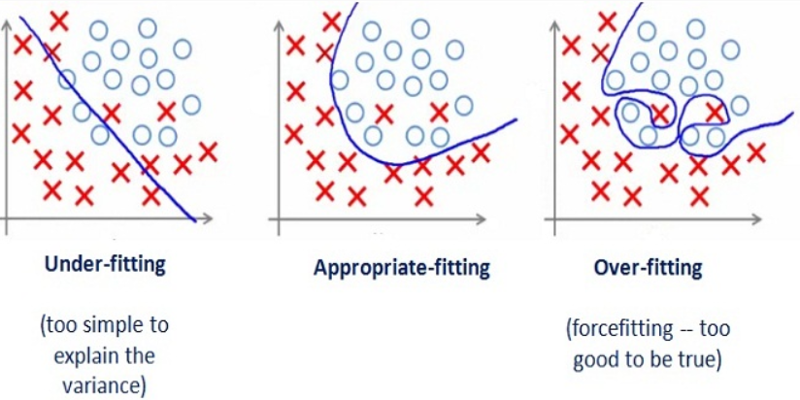
Underfitting and overfitting
Notes:
Source: https://medium.com/greyatom/what-is-underfitting-and-overfitting-in-machine-learning-and-how-to-deal-with-it-6803a989c76

Slide 33
DEMO

Slide 34

Frameworks and libraries

Slide 35
Framework and libraries - Python
SciKit-Learn
PyTorch
TensorFlow 1.x
Keras / TensorFlow 2.x
Theano
Caffe

Slide 36
Framework and libraries - .NET
ML.NET (RC April 2019 – release Q2 2019)
Accord.NET
Infer.NET
numl
Encog Machine Learning Framework
Vulpes
Notes:
Accord.NET:
Classification, Regression, Clustering, Kernels, Imaging, Vision, Audio and Signal
Infer.NET:
Model-based machine learning framework used for research in academic institutions since 2008.
The Infer.NET framework utilizes probabilistic programming to describe probabilistic models which has the added advantage of interpretability.
numl:
General purpose Machine Learning Framework
Encog Machine Learning Framework:
SVM, Neural Networks, Bayesian Networks, Hidden Markov Models, Genetic Programming

Slide 37
Framework and libraries - JavaScript
Auto ML
TensorFlow.js
Keras.js
Brain.js
Convnet.js
ml.js

Slide 38
Framework and libraries - Other
Java:
Weka
Deeplearning4j
Encog Machine Learning Framework
Go:
GoML
MLGo
GoLearn

Slide 39

Cloud platforms

Slide 40
Vendors
Microsoft Azure
Google Cloud
Amazon
IBM Watson

Slide 41
Advantages
Pay-per-use
Scale up
Do not require deep knowledge
Integrated tools like Jupyter notebook
Easier infrastructure integration

Slide 42
Disadvantages
Less flexibility and control over infrastructure
No use of experimental frameworks
Errors can cost a lot of money
Non-Compliant with High Security Protocols
Vendor Lock-In

Slide 43
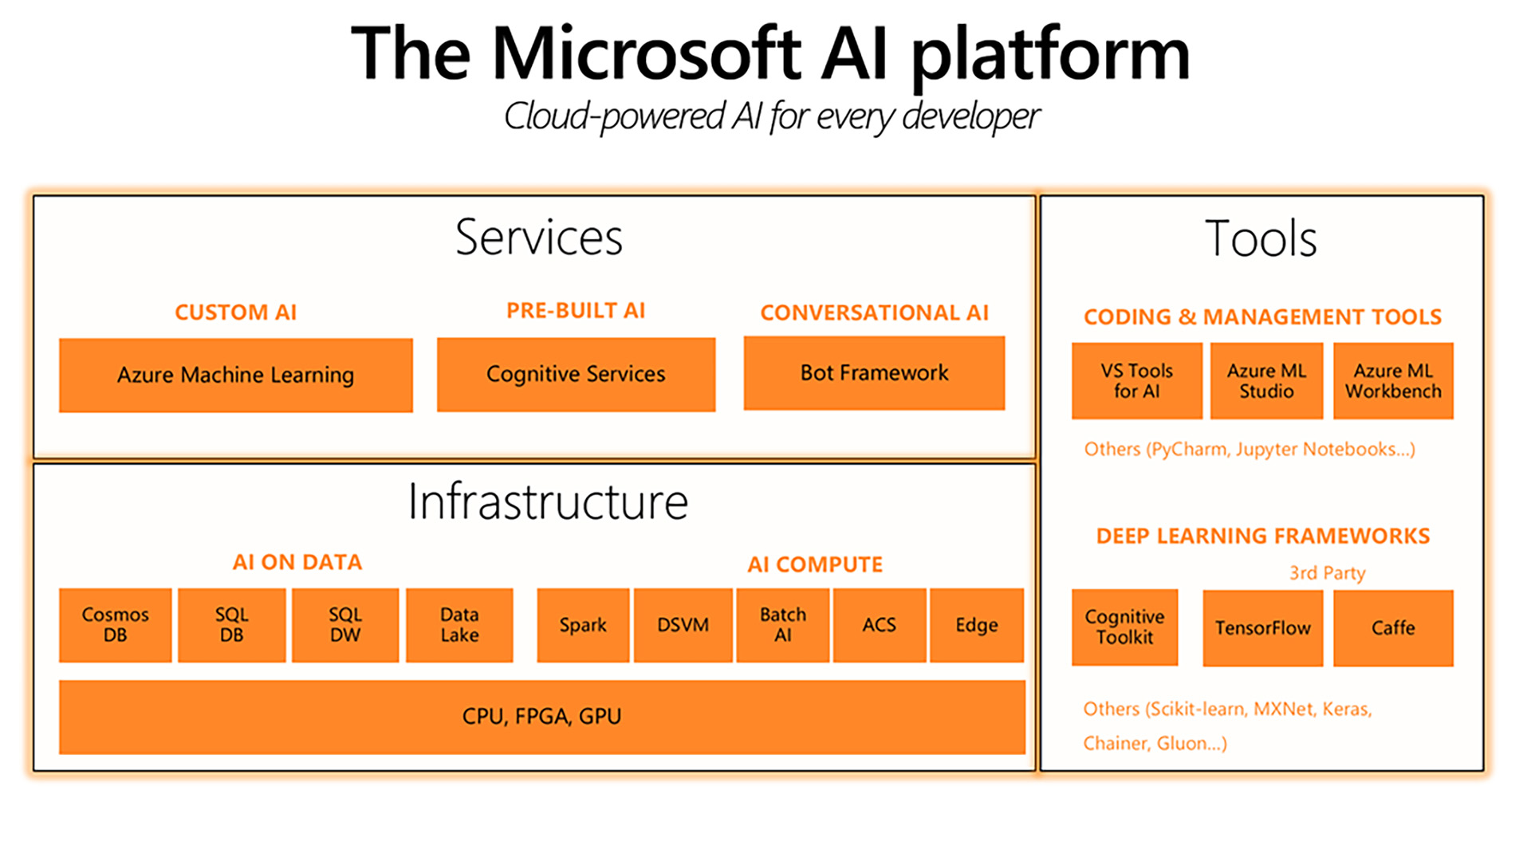
Notes:
Source: https://cloudacademy.com/blog/what-are-the-benefits-of-machine-learning-in-the-cloud/

Slide 44

Future of Machine Learning

Slide 45
Expectations
Improvement of automatic algorithm selection
More complex Neural Networks
Rise in integration of existing and new software projects
Overcome uncanny valley
AI laws

Slide 46

https://github.com/tiebird/Techorama2019-machine-learning-introduction

